Slide 1

BVMS 13.0
Blueprints
Updated: Jul 2025
BVMS 11.1.1
Blueprints
Notes:
Welcome to the BVMS blueprints. This overview explains the deployment scenarios of a typical BVMS or DIVAR IP-based video surveillance system. To design the optimized storage architecture according to the customers requirements, please, use the BVMS Checklist or submit your project to our application designers team.

Slide 2
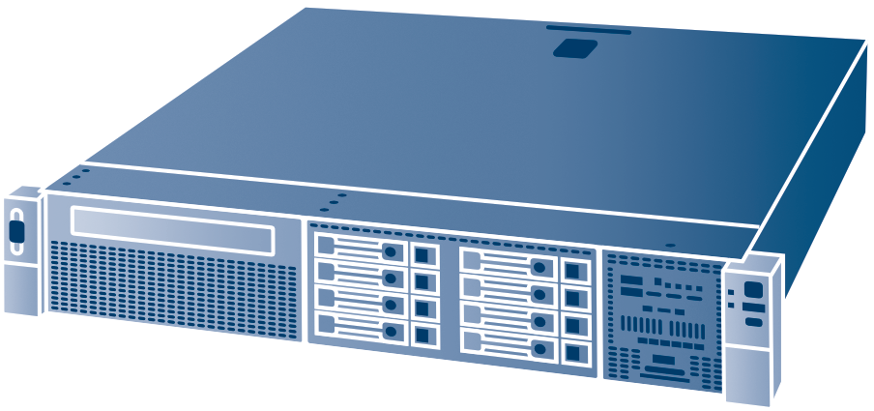
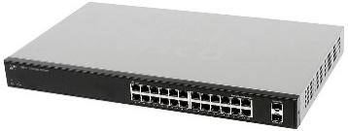
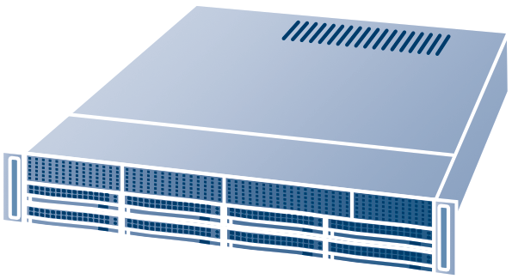

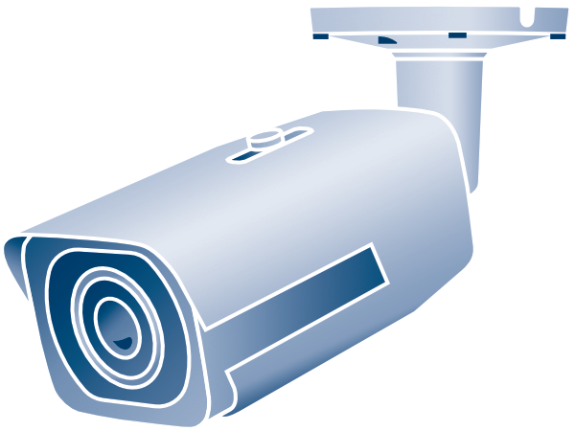
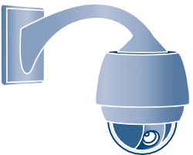

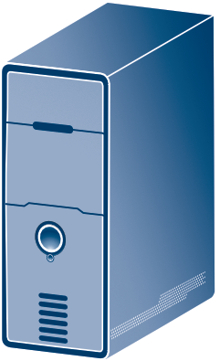
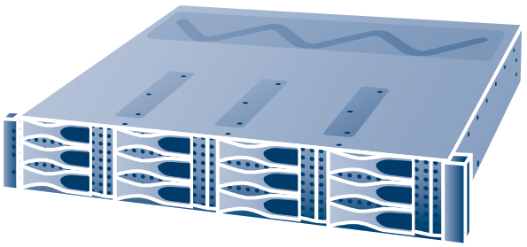

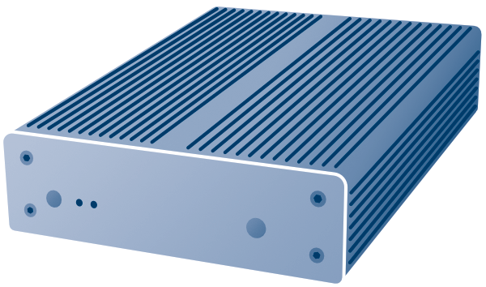
Different key components
BVMS Blueprints
BLACK = 100Mbit/s
BLUE = 1Gbit/s
GREEN = 1Gbit/s - 10Gbit/s
Licensing
User Authorizations
System logging (SQL)
Alarm management
Configuration management
RECORDING MANAGEMENT
2000 CAMERAS
2 MILLION OF 1Gbit/s BLOCKS
STORAGE VIRTUALIZATION
BVMS Server
VRM Server
VRM
VSG
iSCSI
HW DYNAMIC TRANSCODING
DIVAR IP AIO
iSCSI only
HIGH DENSITY
1250 MB WRITE/READ
Support VRM based Multipathing for cameras
Operator client
DSA E-series
ONVIF CAMERAS
H264 via RTSP
JPEG via HTTP
32 CHANNELS / VSG
Monitor Wall
Video Streaming Gateway
Notes:
Let’s start with an overview of the components. The BVMS management server is responsible for licensing, user authorization, logs, configuration management, and alarm management. The video surveillance operator uses the operator client to look at live and recorded video, processes alarms, and monitors the security situation of an environment. The decoders, driving a monitor wall, assist a team of operators to collaboratively solve security incidents. The VRM server is responsible for the recording management of up to 2000 cameras. The DIVAR IP (All-in-one) serves as an all-in-one BVMS system or a video surveillance storage device. The DSA E-series are a high performance video surveillance iSCSI storage system. Last, the video streaming gateway acts as a bridge between the Bosch video surveillance components and ONVIF cameras.

Slide 3
BVMS
Lite, Plus, Professional
BVMS
PROFESSIONAL
Plus
LITE
Notes:
BVMS comes in three editions: Professional, Plus, and Lite. The deployment scenarios presented in this section are valid for all editions, considering their limitations. For example, BVMS Lite can manage up to 42 cameras, BVMS Plus can manage up to 256 cameras, and BVMS Professional can manage up to 2000 cameras.

Slide 4
BVMS all in one
BVMS Blueprints
Cameras
500*
max
CLIENTS
10
max
BLACK = 100Mbit/s
BLUE = 1Gbit/s
GREEN = 1Gbit/s - 10Gbit/s
BVMS Server
VRM Server
Operator client
VSG
iSCSI
HW DYNAMIC TRANSCODING
* Max 500 devices (cameras, replays, inputs, etc.) in logical tree if BVMS MS and VRM server on the same hardware
DIVAR IP AIO iSCSI only
DIVAR IP AIO
iSCSI only
Notes:
The BVMS management server and VRM can run on one physical server when the video surveillance system does not have over 500 cameras. In this case, the DIVAR IP All-in-one devices or a DSA E-series can act as storage devices. The DIVAR IP All-in-one can also act as a VSG or transcoding resource.

Slide 5
Embedded VRM’s
BVMS Blueprints
CAMERAS
500
max
CLIENTS
100
max
VRM
125
max
BLACK = 100Mbit/s
BLUE = 1Gbit/s
GREEN = 1Gbit/s - 10Gbit/s
BVMS Server +
VRM
Operator client
VRM
VSG
iSCSI
HW DYNAMIC TRANSCODING
iSCSI array NETAPP
DIVAR IP AIO 7000
Notes:
The VRM can also be distributed on the DIVAR IP all-in-ones that act as video surveillance storage. Each VRM, running on a DIVAR IP all-in-one 7000 can manage up to 256 cameras. A VRM running on a DIVAR IP all-in-one 5000 can manage up to 42 cameras.

Slide 6
Dedicated VRM
BVMS Blueprints
NOIR = 100Mbit/sits
BLEU = 1Gbit/sits
VERT = 1Gbit/sits - 10Gbit/sits
CAMERAS
2000
max
CLIENTS
100
max
VRM
125
max
BLACK = 100Mbit/s
BLUE = 1Gbit/s
GREEN = 1Gbit/s - 10Gbit/s
BVMS Server
VRM Server
Operator client
iSCSI array NETAPP
DIVAR IP AIO
iSCSI only
Notes:
We recommend to install a separate VRM server for larger video surveillance installations.

Slide 7
Dedicated VRM & Failover
BVMS Blueprints
CAMERAS
2000
max
CLIENTS
100
max
VRM
125
max
BLACK = 100Mbit/s
BLUE = 1Gbit/s
GREEN = 1Gbit/s - 10Gbit/s
BVMS Server
VRM Server
VRM Server
“Failover”
Operator client
iSCSI array NETAPP
DIVAR IP AIO
iSCSI only
Notes:
Projects that require redundant replay capabilities need an additional fail-over VRM server. The fail-over servers takes over the replay and block distribution functionality of the primary VRM if it fails.

Slide 8
Distributed storage
BVMS Blueprints
CAMERAS
2000
max
CLIENTS
100
max
VRM
125
max
POOL
120/VRM
max
BLACK = 100Mbit/s
BLUE = 1Gbit/s
GREEN = 1Gbit/s - 10Gbit/s
BVMS Server
VRM Server
Operator client
Building A “Pool X”
Building B “Pool Z”
iSCSI array NETAPP
iSCSI array NETAPP
DIVAR IP AIO
iSCSI only
DIVAR IP AIO
iSCSI only
Notes:
There are two options when storage devices are located in multiple buildings on a campus. You can distribute the storage and centralize the VRM. This reduces the (maintenance) cost of the system, but also reduces the resilience and performance.

Slide 9
Distributed VRM’s
BVMS Blueprints
CAMERAS
2000
max
CLIENTS
100
max
VRM
125
max
BLACK = 100Mbit/s
BLUE = 1Gbit/s
GREEN = 1Gbit/s - 10Gbit/s
BVMS Server
Operator client
Building A “VRM A”
Building B “VRM B”
iSCSI array NETAPP
iSCSI array NETAPP
DIVAR IP AIO iSCSI only
DIVAR IP AIO
iSCSI only
VRM Server
VRM Server
Notes:
When you distribute VRMs you increase the replay performance of the system and you create virtual problem domains. This makes it easier to troubleshoot recording and replay issues. Additionally, if one VRM fails, the failure is limited to a specific part of the system.

Slide 10
Mirrored recording
BVMS Blueprints
CAMERAS
2000
max
CLIENTS
100
max
BLACK = 100Mbit/s
BLUE = 1Gbit/s
GREEN = 1Gbit/s - 10Gbit/s
BVMS Server
Same stream on both storage
Same stream on both storage
Same stream on both storage
Primary storage
Mirrored storage
iSCSI array NETAPP
iSCSI array NETAPP
DIVAR IP AIO iSCSI only
DIVAR IP AIO
iSCSI only
Primary VRM Server
Secondary VRM Server
Notes:
Mirrored recording duplicates the video on two identical storage devices. If one storage devices fails, the operator can continue to replay video footage from the second storage device.

Slide 11
Dual recording
BVMS Blueprints
CAMERAS
2000
max
CLIENTS
100
max
BLACK = 100Mbit/s
BLUE = 1Gbit/s
GREEN = 1Gbit/s - 10Gbit/s
BVMS Server
Quality 1
Quality 2
Frame Rate 1
Frame Rate 2
One storage only
Primary storage
Dual storage
iSCSI array NETAPP
iSCSI array NETAPP
DIVAR IP AIO iSCSI only
DIVAR IP AIO
iSCSI only
Primary VRM Server
Secondary VRM Server
Notes:
Dual recording is similar to mirrored recording, but allows you to change the quality of the video that is stored on the second storage device. This allows operators to replay video from the second video storage device when the primary device has failed, while keeping the costs under control.

Slide 12
SCALABILITY
BVMS
ENTERPRISE
Notes:
BVMS Enterprise allows you to connect multiple BVMS systems, including DIVAR IP all-in-one. The video surveillance operator can access all systems from a single client application and has full control over these systems.

Slide 13
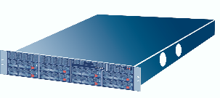
Enterprise environment – Multi-servers
CAMERAS
14.000
max
CLIENTS
100
max
SUBSYSTEMS
100
max
BVMS Blueprints
BLACK = 100Mbit/s
BLUE = 1Gbit/s
GREEN = 1Gbit/s - 10Gbit/s
Up to 100 subsystems connected to EMS
Up to 2.000 cameras per subsystem.
Up to 100 Enterprise user-groups.
Up to 14.000 cameras per user-group (Note: Performance workstation
required, min.16GB RAM for the Enterprise Operator Client
Subsystems: BVMS (Lite, Plus, Professional),
DIVAR IP AIO 4000/6000/7000
BVMS Professional Server
BVMS Professional
Operator client
We recommend to use a secure connection, for example, SSH or VPN, to allow multiple locations to communicate.
Sub-system A
Sub-system B
BVMS Server
DIVAR IP AIO 7000
Minimum speed: 10Mbit/s.
Recommended speed: 100Mbit/s
(network speed has an impact on the start-up time of the enterprise operator client and the number of video streams that can be displayed).
Operator client
iSCSI array NETAPP
Operator client
DIVAR IP AIO
VRM Server
Notes:
BVMS Enterprise can handle up to 100 subsystems. One video surveillance operator can access up to 14.000 cameras at the same time. In this case we assume that the entire system is connected to a private (or transparent) network. The Enterprise Operator Client communicates directly to the subsystem and the devices located in the context of the subsystem.

Slide 14
Enterprise – BVMS Plus
CAMERAS
14.000
max
CLIENTS
100
max
SUBSYSTEMS
20
max
BVMS Blueprints
BLACK = 100Mbit/s
BLUE = 1Gbit/s
GREEN = 1Gbit/s - 10Gbit/s
Up to 20 subsystems connected to EMS
Up to 2.000 cameras per subsystem.
Up to 100 Enterprise user-groups.
Up to 14.000 cameras per user-group (Note: Performance workstation
required, min.16GB RAM for the Enterprise Operator Client
Subsystems: BVMS (Lite, Plus),
DIVAR IP AIO 4000/6000/7000
BVMS Plus Server
(or DIVAR IP AiO 7000)
BVMS Plus
Operator client
We recommend to use a secure connection, for example, SSH or VPN, to allow multiple locations to communicate.
Sub-system A
Sub-system B
BVMS Server
DIVAR IP AIO 7000
Minimum speed: 10Mbit/s.
Recommended speed: 100Mbit/s
(network speed has an impact on the start-up time of the enterprise operator client and the number of video streams that can be displayed).
Operator client
iSCSI array NETAPP
Operator client
DIVAR IP AIO
VRM Server
Notes:
BVMS Enterprise bason BVMS Plus can handle up to 20 subsystems. One video surveillance operator can access up to 14.000 cameras at the same time. In this case we assume that the entire system is connected to a private (or transparent) network. The Enterprise Operator Client communicates directly to the subsystem and the devices located in the context of the subsystem.

Slide 15
Enterprise – Multi-servers (SSH)
BVMS Blueprints
BLACK = 100Mbit/s
BLUE = 1Gbit/s
GREEN = 1Gbit/s - 10Gbit/s
SSH connectivity between Enterprise Operator client and Enterprise subsystem.
BVMS Management Server or DIVAR IP AIO can route at least 50Mbit/s between Enterprise network and video network.
BVMS Enterprise Server
(Plus or Professional)
BVMS
Operator client (Enterprise)
We recommend to use a secure connection, for example, SSH or VPN, to allow multiple locations to communicate.
Sub-system A
Sub-system B
BVMS Server
BVMS Server or DIVAR IP AIO acts as bridge between Enterprise and Video network.
Minimum speed: 10Mbit/s.
Recommended speed: 100Mbit/s
(network speed has an impact on the start-up time of the enterprise operator client and the number of video streams that can be displayed).
DIVAR IP AIO
Operator client
iSCSI array NETAPP
Operator client
DIVAR IP AIO
VRM Server
Notes:
In this case we assume the system runs on a larger public network. The BVMS management server or DIVAR IP all-in-one is used as a gateway between the local video surveillance network and the corporate network that hosts the Enterprise environment. The Enterprise operator client connects to the management server of the subsystem. The management server routes traffic between the video surveillance network and corporate network.

Slide 16
LOW BANDWIDTH CONNECTIONS
BVMS
Unmanaged sites
Notes:
Unmanaged sites offers, compared to BVMS Enterprise, reduced functionality but increased scalability.

Slide 17




Unmanaged sites
BVMS Blueprints
SITES
9999
max
CLIENTS
100
max
DEVICES
5 max
per site
NO
STATUS
BLACK = 100Mbit/s
BLUE = 1Gbit/s
GREEN = 1Gbit/s - 10Gbit/s
RED = >1Mb
NO
ALARM
CONNECTION ON DEMAND
(max 20 simultaneous connections / client)
Use VPN or SSH (Device port forwarding not recommended due to security risks!)
BVMS Server
Operator client
Site 9
Up to 16 local recording cameras
Site 1
Site 2
Site 5
Site 6
DVR 400 series
DVR 600 series
BVMS Server + DIP AIO 7000
Site 3
Site 4
Site 7
Site 8
DVR 700 series
DIVAR AN series
MIX (up to 4 x DIVAR AN + 1 x DIP AIO)
DIP AIO 7000
DIP AIO 5000
Setup DVR cameras profil and bandwidth limits accordings to the available bandwidth and simultaneous video streams to be transmitted via WAN
Notes:
The BVMS management server hosts an address book of unmanaged sites. The operator client loads the address book but does not connect to a site until it is instructed to do so by the system operator. Unmanaged sites can be another BVMS system, DIVAR IP all-in-one, DVR, or a group of cameras. For this use-case we have tested the BVMS management server on Microsoft Azure.

Slide 18
MOBILE APP
BVMS
Unmanaged sites
Notes:
Unmanaged sites offers, compared to BVMS Enterprise, reduced functionality but increased scalability.

Slide 19

Video Security App
BVMS Blueprints
CAMERAS
2000
max
CLIENTS
100
max
VRM
125
max
BLACK = 100Mbit/s
BLUE = 1Gbit/s
GREEN = 1Gbit/s - 10Gbit/s
BVMS Server
VIDEO SECURITY app (iOS & Android)
Operator client
Connections made from Video Security app to each VRM – proper network configuration (ie. VPN) required.
Within VIDEO SECURITY app single site should not contain more, than 256 cameras.
In case of bigger BVMS Professional systems, cameras should be logically distributted to folders, each containing up to 256 cameras.
Building A “VRM A”
Building B “VRM B”
iSCSI array NETAPP
DIVAR IP AIO
(w/ VRM)
VRM Server

Slide 20
BVMS APPLIANCES
DIVAR IP all-in-one 4000
DIVAR IP all-in-one 6000 / 7000
Notes:
DIVAR IP all-in-one is BVMS in a box.

Slide 21
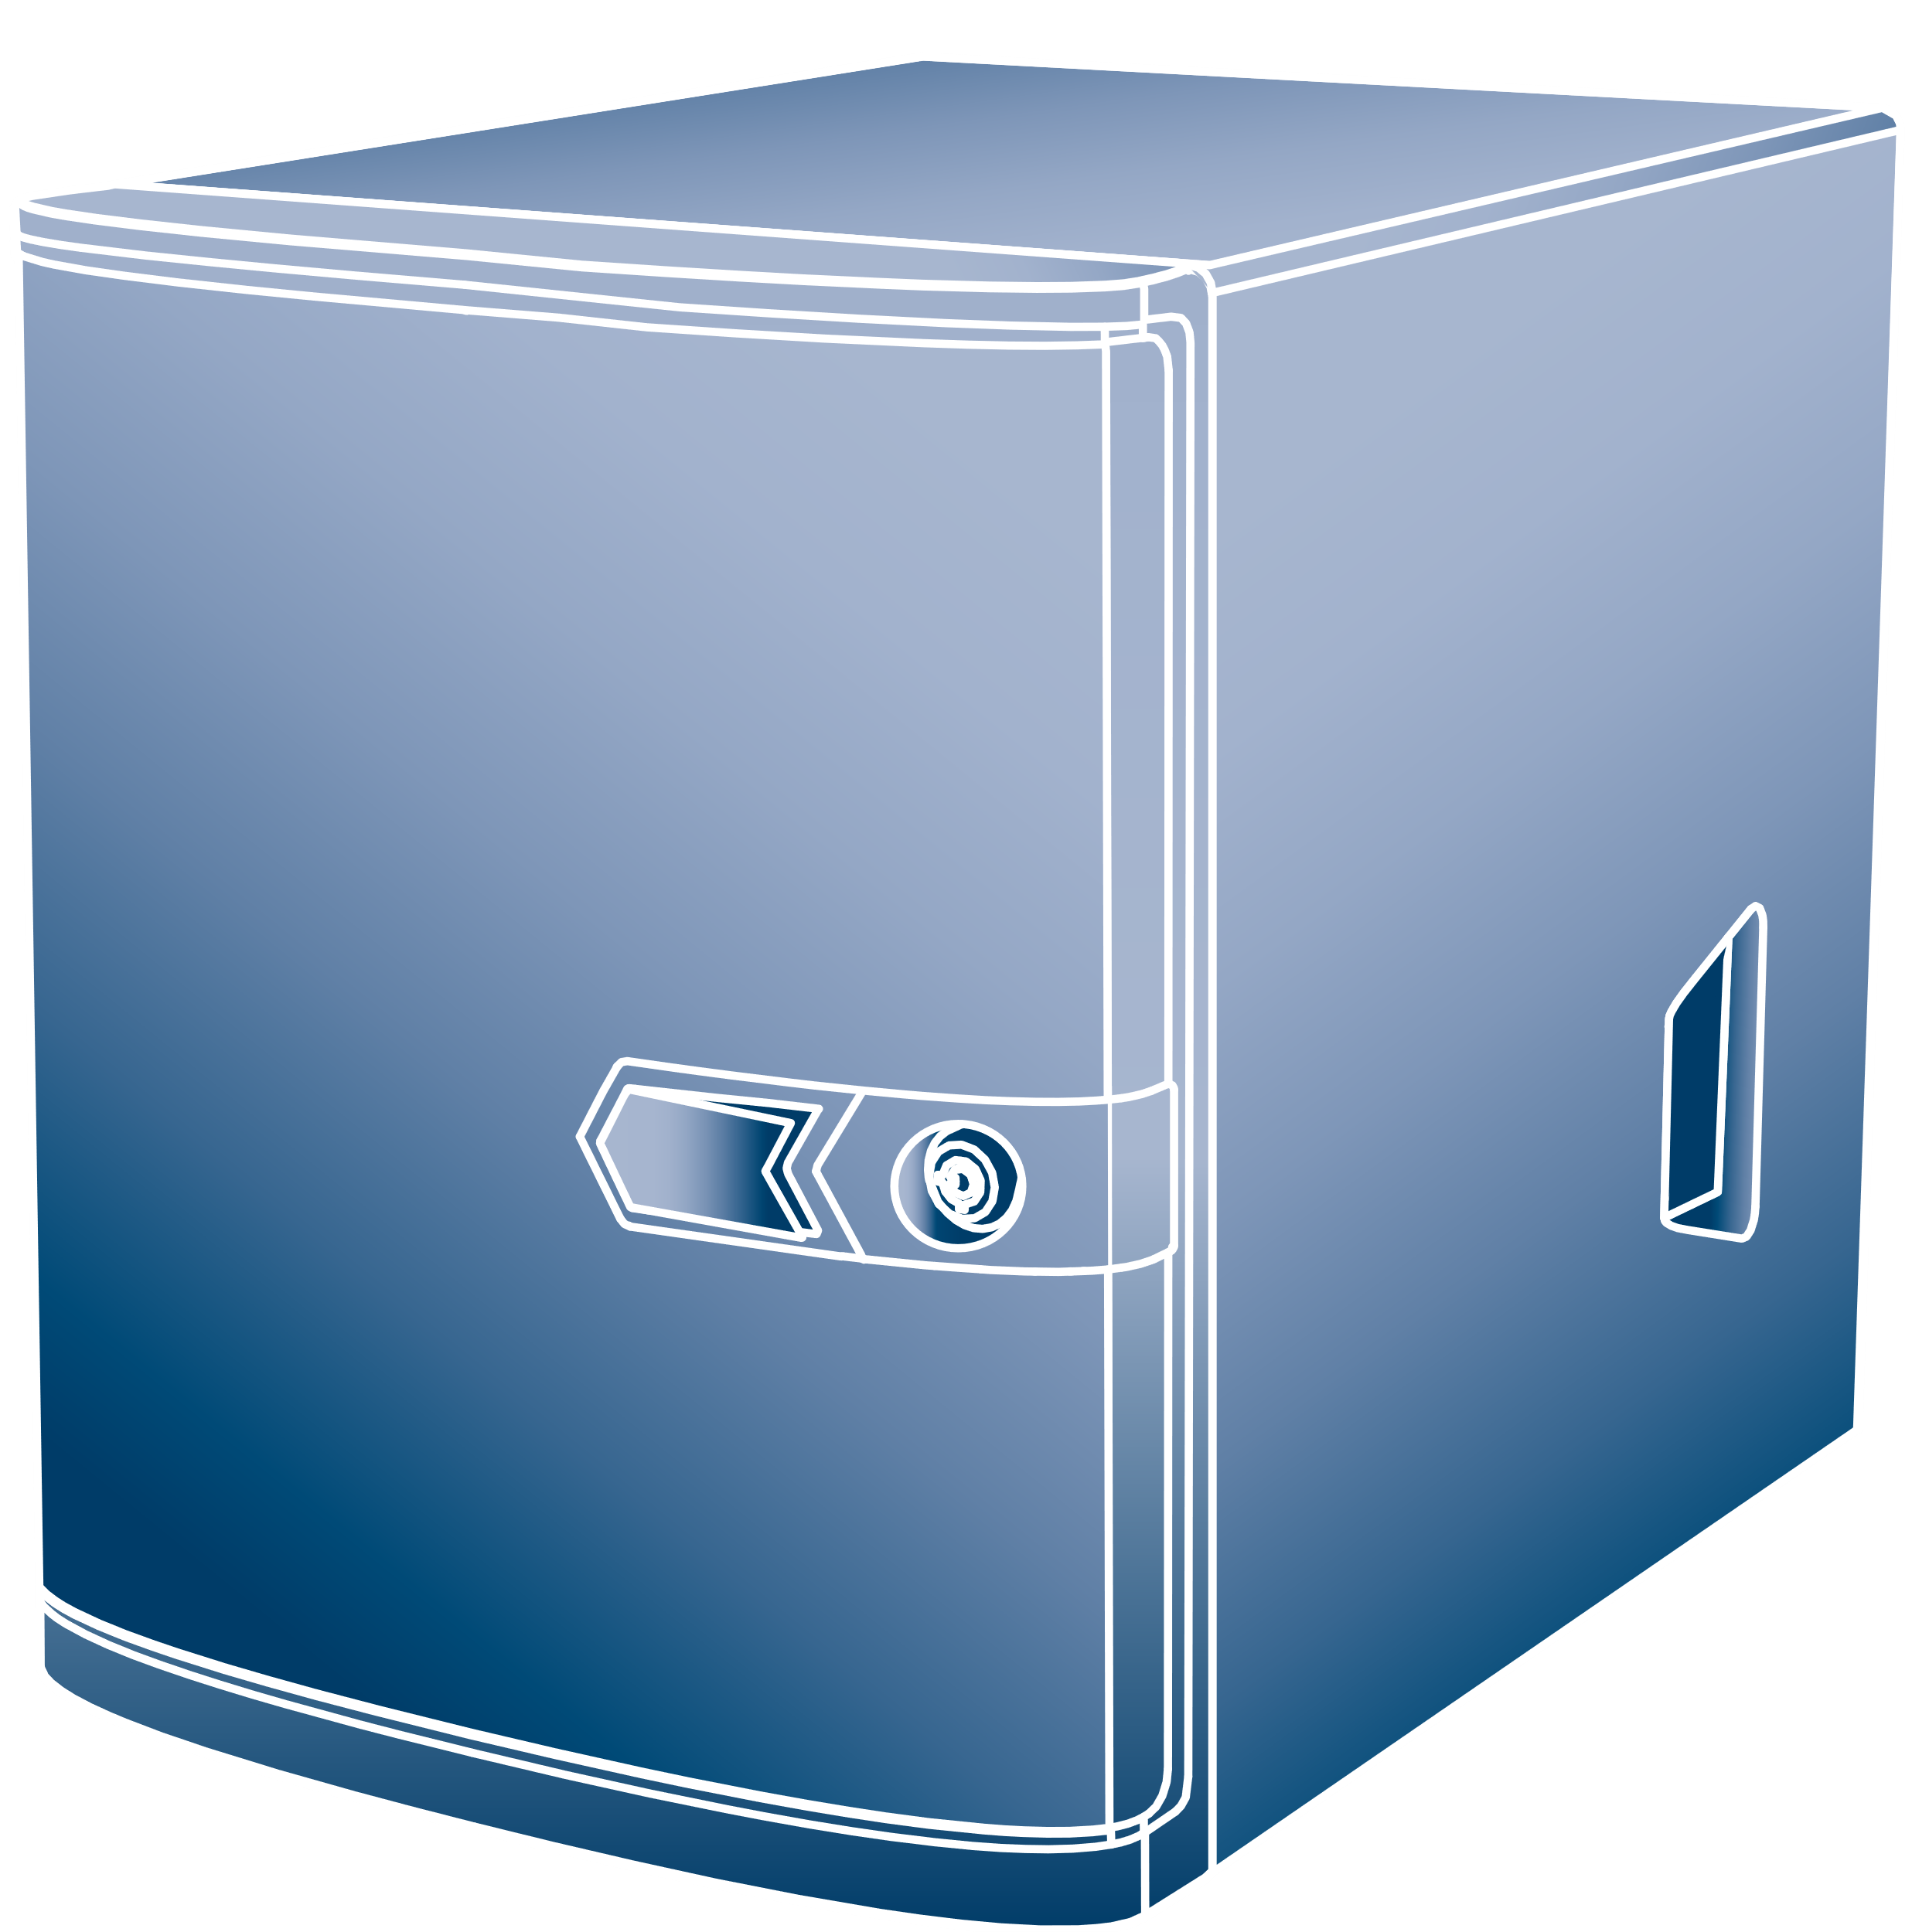


DIVAR IP AIO 4000
BVMS Blueprints
CAMERAS
32
max
CLIENTS
5
max
Expansion
2
max
BLACK = 100Mbit/s
BLUE = 1Gbit/s
GREEN = 1Gbit/s - 10Gbit/s
BVMS
VRM
VSG
iSCSI
HW DYNAMIC TRANSCODING
DIVAR IP AIO 4000
VIDEO SECURITY APP (iOS & Android)
Operator client
DIVAR IP AIO 4000
Up to 2 DIVAR IP AIO 4000 storage expansions per system.
DIVAR IP AIO 4000
Notes:
The DIVAR IP AiO 4000 can handle up to 32 cameras and can have two additional storage extensions to ensure the required retention time can be stored. The hardware transcoding service allows the Video Security Client to connect to the DIVAR IP AiO 4000.

Slide 22
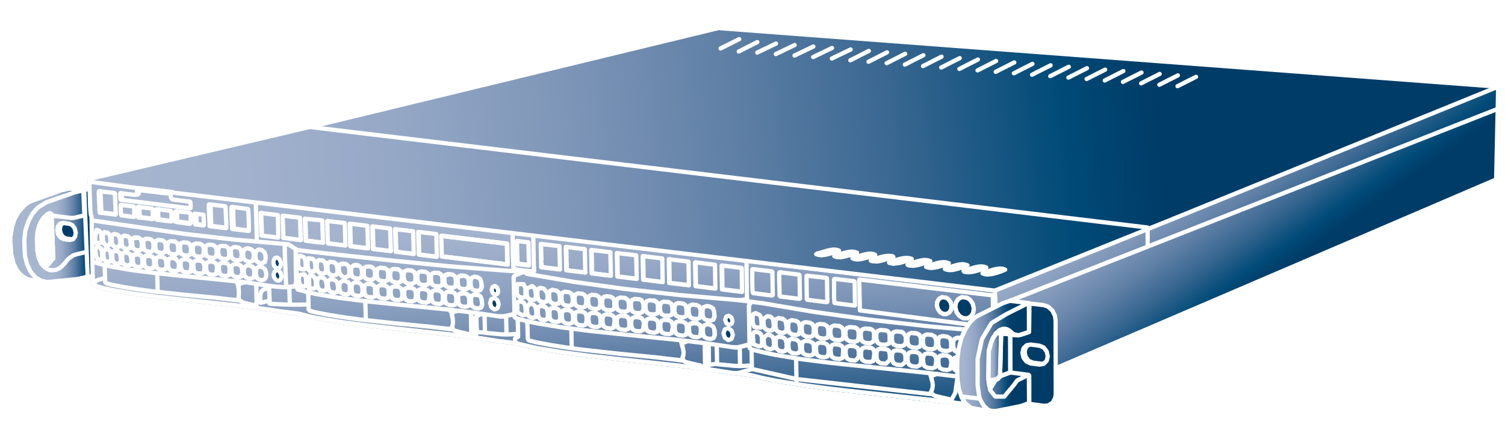
DIVAR IP AIO 6000 + Storage
BVMS Blueprints
CAMERAS
64
max
CLIENTS
20
max
Expansion
2
max
BLACK = 100Mbit/s
BLUE = 1Gbit/s
GREEN = 1Gbit/s - 10Gbit/s
BVMS
VRM
VSG
iSCSI
HW DYNAMIC TRANSCODING
DIVAR IP AIO 6000
VIDEO SECURITY APP (iOS & Android)
Operator client
VRM
VSG
iSCSI
HW DYNAMIC TRANSCODING
DIVAR IP AIO
Notes:
The DIVAR IP AiO 6000 can handle up to 64 cameras and can have additional storage extensions to ensure the required retention time can be stored. The hardware transcoding service allows the Video Security Client to connect to the DIVAR IP AiO 6000.

Slide 23

DIVAR IP AIO 7000 + Storage
BVMS Blueprints
CAMERAS
256
max
CLIENTS
10
max
Expansion
4
max
BLACK = 100Mbit/s
BLUE = 1Gbit/s
GREEN = 1Gbit/s - 10Gbit/s
BVMS
VRM
VSG
iSCSI
HW DYNAMIC TRANSCODING
DIVAR IP AIO 7000
VIDEO SECURITY APP (iOS & Android)
Operator client
VRM
VSG
iSCSI
HW DYNAMIC TRANSCODING
DIVAR IP AIO 7000
Notes:
The DIVAR IP AiO 7000 can handle up to 256 cameras and can have additional storage extensions to ensure the required retention time can be stored. The hardware transcoding service allows the Video Security Client to connect to the DIVAR IP AiO 7000.

Slide 24
VIDEO STREAMING GATEWAY
BVMS
OPENNESS
Notes:
BVMS is an ONVIF Profile S compliant client. The Video Streaming Gateway acts as an ONVIF bridge between the ONVIF cameras and the rest of the components in BVMS.

Slide 25

Video Streaming Gateway
BVMS Blueprints
CHANNELS
32/VSG
max
BLACK = 100Mbit/s
BLUE = 1Gbit/s
GREEN = 1Gbit/s - 10Gbit/s
VRM B
ONVIF
JPEG via HTTP
H264 via RTSP
BVMS Server
Operator client
VRM A
ONVIF
JPEG via HTTP
H264 via RTSP
VRM Server
VSG 01
DIVAR IP AIO (VSG include)
Overall max 550 Mbit
iSCSI array NETAPP
VSG n
Notes:
Each Video Streaming Gateway can handle up to 32 video channels. One operating system can run up to 7 instances of the Video Streaming Gateway. One operating system can therefore handle up to 224 cameras. The Video Streaming Gateway can be virtualized as well, but this might impact its performance. The Video Streaming Gateway can connect to ONVIF cameras, retrieve video using JPEG via HTTP, or RTSP.

Slide 26
ACCESS CONTROL INTEGRATION
BVMS & AMS
Notes:
Did you know you can build an integrated access control and video management environment using software and hardware from Bosch?

Slide 27
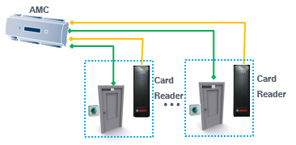
Unified security operation
BVMS & AMS systems integrated
BLACK = 100Mb
BLUE = 1Gb
ORANGE = Wiegand
GREEN = I/O
Security control room: Unified security operation Video & Access
Server room: BVMS and AMS servers coexist in separated servers
BVMS Server
VMS Storage
AMS Server & Database
…
BVMS Client
BVMS client
Switch
Reception: Enrolment process and basic video verification
…
BVMS and AMS Client
Distributed security devices
Notes:
The access management system and BVMS can be combined in one system. We recommend using the BVMS operator client for operational security management while using the access management system client for cardholder management at the reception desk or facilities management.

Slide 28
BVMS VIEWER
Notes:
BVMS Viewer is a video viewing client for installations that do not require advanced security management functionality.

Slide 29
BVMS Viewer
BVMS Blueprints
CAMERAS
500
max
CLIENTS
1
max
BLACK = 100Mbit/s
BLUE = 1Gbit/s
GREEN = 1Gbit/s - 10Gbit/s
Free of charge:
16 live only / local storage cameras
5 Recording solutions (DVR, VRM device)
16 unmanaged sites (max 1 simultaneous connection)
Max limit: 500 cameras in logical tree.
Bosch VMS Viewer
SSite
Site
DIP AIO 5000
CONNECTION ON DEMAND
(max 1 simultaneous connection)
DIVAR IP AIO
Live only / local storage
cameras
DIVAR AN series
DIVAR network and hybrid
Notes:
BVMS Viewer can handle up to 500 cameras and connects directly to its subsystems. Compared to other BVMS versions BVMS Viewer does not have event and alarm management capabilities and does not have a server component that stores events.

Slide 30

BVMS

